Slide 1
WebSocket
Parker zhou
parkerzho2010@gmail.com

Slide 2
Why Not HTTP?
HTTP is not duplex, each response from server must have a corresponding request from client(browser)
HTTP can not support Real-time application(monitor\chat\stock)
ajax-long-pulling and Comet are both waste server and bandwidth, and also have latency

Slide 3
Why WebSocket?
After create a connection, sever is able to send message to client at any time, in other words, client can listen the message from server, without any additional request.
Sounds like socket, but implemented in application layer.

Slide 4
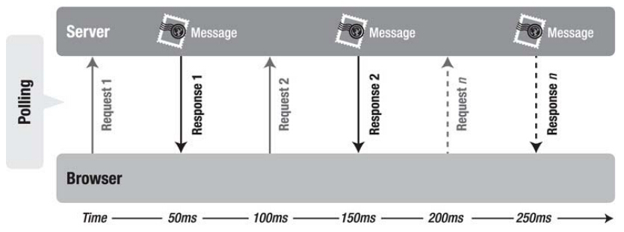
HTTP vs Websocket
Latency
More bandwidth

Slide 5
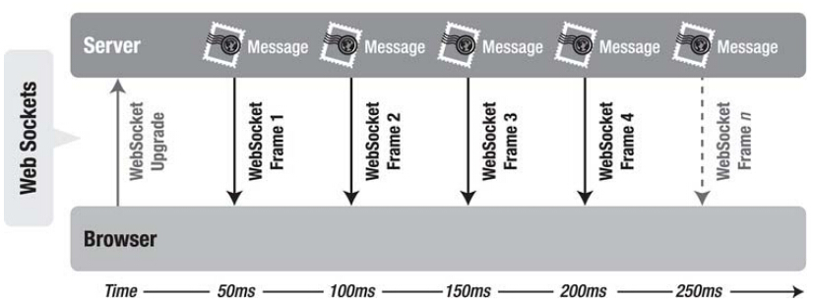
HTTP vs Websocket
Real-time
Simple data frame

Slide 6
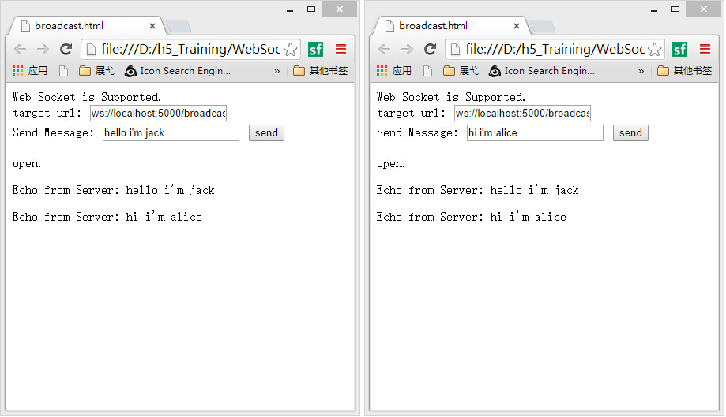
Quick Example
Chat example

Slide 7
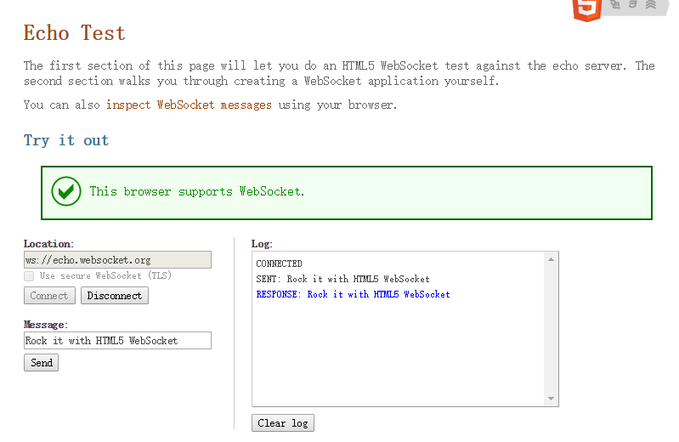
Quick Example
http://www.websocket.org/echo.html

Slide 8
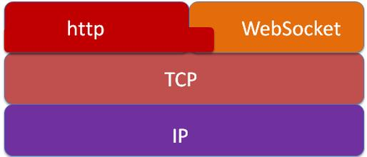
WebSocket And HTTP

Slide 9
WebSocket URI
ws-URI = "ws:" "//" host [ ":" port ] path [ "?" query ]
wss-URI = "wss:" "//" host [ ":" port ] path [ "?" query ]

Slide 10
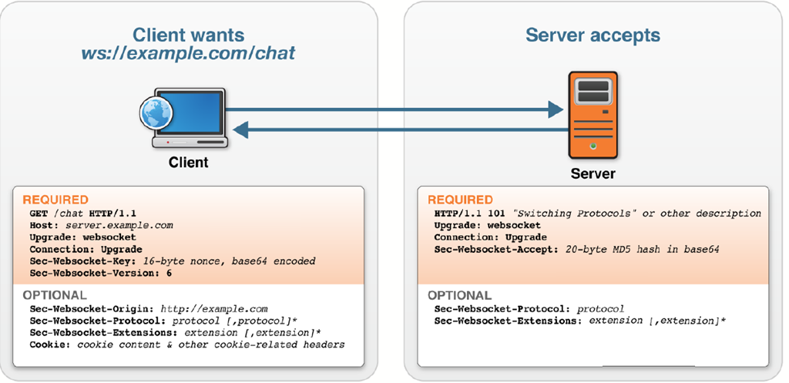
Handshake

Slide 11
Handshake
Connection: Upgrade
Upgrade: websocket
complete the HTTP Upgrade to WebSocket
Required

Slide 12
Handshake
Required
Sec- WebSocket-Version
The value of this header field MUST be 13

Slide 13
Handshake
Sec-WebSocket-Key
if decoded, is 16 bytes in length
Sec-WebSocket-Accept
base64encode(sha1(Sec-WebSocket-Key+258EAFA5-E914-47DA-
95CA-C5AB0DC85B11))
Required

Slide 14
Handshake
Sec-WebSocket-Protocol
Custom application-level protocols layered over the WebSocket protocol
Optional

Slide 15
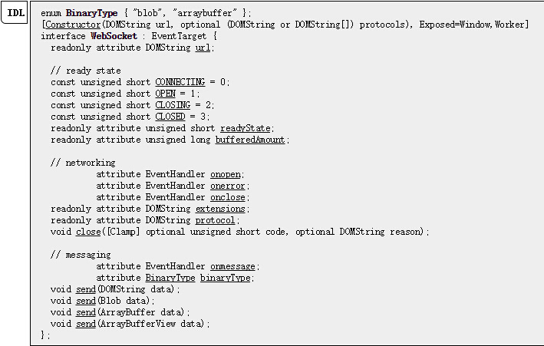
WebSocket Interface

Slide 16
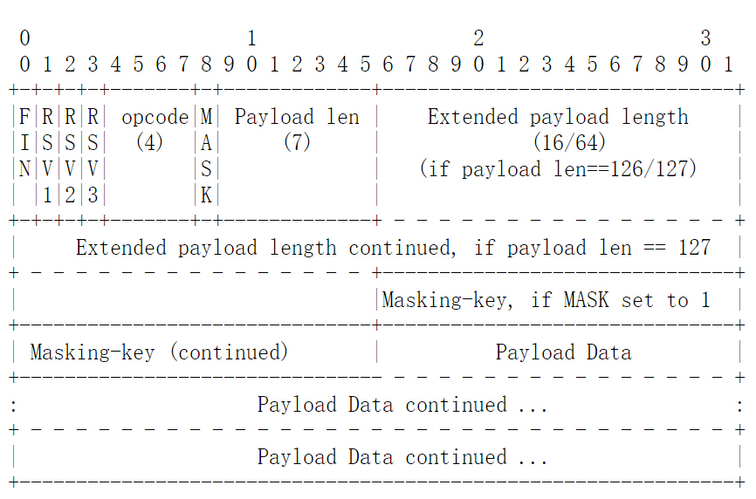
Data Frame
Notes:
FIN: 1 bit
Indicates that this is the final fragment in a message.
RSV1, RSV2, RSV3: reserved for extension
Opcode:
4 bits Defines the interpretation of the payload data. If an unknown opcode is received, the receiving endpoint MUST _Fail the WebSocket Connection_. The following values are defined.
* %x0 denotes a continuation frame
* %x1 denotes a text frame
* %x2 denotes a binary frame
* %x3-7 are reserved for further non-control frames
* %x8 denotes a connection close
* %x9 denotes a ping
* %xA denotes a pong
* %xB-F are reserved for further control frames
Mask: 1
bit Defines whether the payload data is masked. If set to 1, a masking key is present in masking-key, and this is used to unmask the payload data.
Payload length: 7 bits, 7+16 bits, or 7+64 bits
The length of the payload data, in bytes: if 0-125, that is the payload length. If 126, the following 2 bytes interpreted as a 16 bit unsigned integer are the payload length. If 127, the following 8 bytes interpreted as a 64-bit unsigned integer (the most significant bit MUST be 0) are the payload length. Multibyte length quantities are expressed in network byte order. Note that in all case the minimal number of bytes MUST be used to encode the length, for example the length of a 124 byte long string can't be encoded as the sequence 126, 0, 124. The payload length is the length of the extension data + the length of the application data. The length of the extension data may be zero, in which case the payload length is the length of the application data.
Masking-key: 0 or 4 bytes
All frames sent from the client to the server are masked by a 32- bit value that is contained within the frame. This field is present if the mask bit is set to 1, and is absent if the mask bit is set to 0.

Slide 17
Data Frame
MSK0
MSK1
MSK2
MSK3
XOR
PLB0
PLB1
PLB2
PLB3
PLB4
PLB5
PLB5
PLB6
MPLB0
MPLB1
MPLB2
MPLB3
MPLB4
MPLB5
MPLB5
MPLB6
Notes:
FIN: 1 bit
Indicates that this is the final fragment in a message.
RSV1, RSV2, RSV3: reserved for extension
Opcode:
4 bits Defines the interpretation of the payload data. If an unknown opcode is received, the receiving endpoint MUST _Fail the WebSocket Connection_. The following values are defined.
* %x0 denotes a continuation frame
* %x1 denotes a text frame
* %x2 denotes a binary frame
* %x3-7 are reserved for further non-control frames
* %x8 denotes a connection close
* %x9 denotes a ping
* %xA denotes a pong
* %xB-F are reserved for further control frames
Mask: 1
bit Defines whether the payload data is masked. If set to 1, a masking key is present in masking-key, and this is used to unmask the payload data.
Payload length: 7 bits, 7+16 bits, or 7+64 bits
The length of the payload data, in bytes: if 0-125, that is the payload length. If 126, the following 2 bytes interpreted as a 16 bit unsigned integer are the payload length. If 127, the following 8 bytes interpreted as a 64-bit unsigned integer (the most significant bit MUST be 0) are the payload length. Multibyte length quantities are expressed in network byte order. Note that in all case the minimal number of bytes MUST be used to encode the length, for example the length of a 124 byte long string can't be encoded as the sequence 126, 0, 124. The payload length is the length of the extension data + the length of the application data. The length of the extension data may be zero, in which case the payload length is the length of the application data.
Masking-key: 0 or 4 bytes
All frames sent from the client to the server are masked by a 32- bit value that is contained within the frame. This field is present if the mask bit is set to 1, and is absent if the mask bit is set to 0.

Slide 18
Detail Example
See how to write a simple websocket server using python(asyncore)
See how to use websocket interface in javascript client

Slide 19
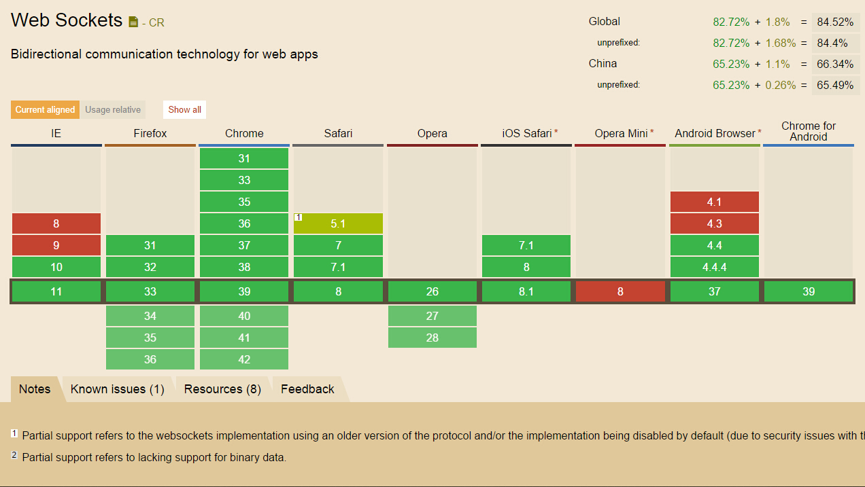
Browser Support

Slide 20
References:
The WebSocket protocol draft-ietf-hybi-thewebsocketprotocol-17
(W3C)The WebSocket API
Notes:
Method : CONNECT

